Slide 1

CSP31A Big Data Analytics
School of Computer Engineering and Technology

Slide 2
CSP31A Big Data Analytics
Teaching Scheme Credits: 02 + 01
Theory: 3 Hrs / Week Practical: 2Hrs/Week
Course Objectives:
Understand the various aspects of Big Data.
Learn the concepts of NoSQL for Big Data.
Design an application for distributed systems on Big Data.
Explore the various Big Data visualization tools.
Course Outcomes:
Apply the insights of Big Data in business applications.
Illustrate the application of MongoDB in real world applications.
Build hadoop based distributed systems for real world problem.
Apply and utilize big data visualization tools for real world applications.

Slide 3
LABORATORY ASSIGNMENT NO: 02
Aggregation and Indexing in MongoDB

Slide 4
Aggregation and Indexing in MongoDB

Slide 5
Index Operations in MongoDB
Creation index
db.users.ensureIndex( { score: 1 } )
Show existing indexes
db.users.getIndexes()
Drop index
db.users.dropIndex( {score: 1} )
Explain—Explain
db.users.find().explain()
Returns a document that describes the process and indexes
Hint
db.users.find().hint({score: 1})
Overide MongoDB’s default index selection

Slide 6
Index Creation
Using CreateIndex
db.CollectionName.createIndex( { KeyName: 1 or -1})
Using ensureIndex
db.CollectionName.ensureIndex({KeyName: 1 or -1})
1 for Ascending Sorting
-1 for Descending Sorting

Slide 7


Index Creation
Using CreateIndex
Using ensureIndex
Single: db.stud.createIndex( { zipcode: 1})
Compound: db.stud.createIndex( { dob: 1, zipcode: -1 } )
Unique: db.stud.createIndex( { rollno: 1 }, { unique: true } )
Sparse: db.stud.createIndex( { age: 1 }, { sparse: true } )
Single: db.stud.ensureIndex({“name":1})
Compound: db.stud.ensureIndex ({“address":1,“name":-1})

Slide 8
Index Display
db.collection.getIndexes()
Returns an array that holds a list of documents that identify and describe the existing indexes on the collection.
db.collection.getIndexStats()
Displays a human-readable summary of aggregated statistics about an index’s B-tree data structure.
db.<collection>.getIndexStats( { index : "<index name>" } )

Slide 9
Index Drop
Syntax
db.collection.dropIndex()
db.collection.dropIndex(index)
Example
db.stud.dropIndex()
db.stud.dropIndex( { “name" : 1 } )

Slide 10
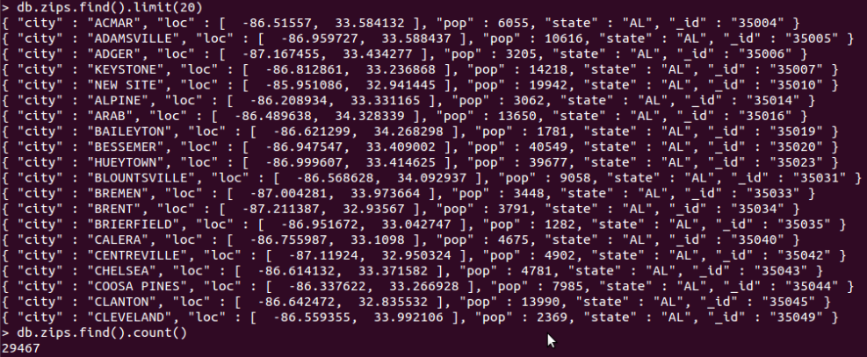
Demo of indexes in MongoDB
Import Data
Create Index
Single Field Index
Compound Field Indexes
Multikey Indexes
Show Existing Index
Hint
Single Field Index
Compound Field Indexes
Multikey Indexes
Explain
Compare with data without indexes

Slide 11

Demo of indexes in MongoDB
Import Data
Create Index
Single Field Index
Compound Field Indexes
Multikey Indexes
Show Existing Index
Hint
Single Field Index
Compound Field Indexes
Multikey Indexes
Explain
Compare with data without indexes

Slide 12
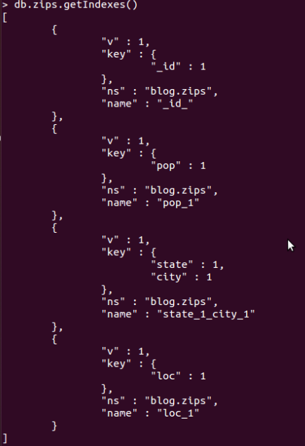
Demo of indexes in MongoDB
Import Data
Create Index
Single Field Index
Compound Field Indexes
Multikey Indexes
Show Existing Index
Hint
Single Field Index
Compound Field Indexes
Multikey Indexes
Explain
Compare with data without indexes

Slide 13
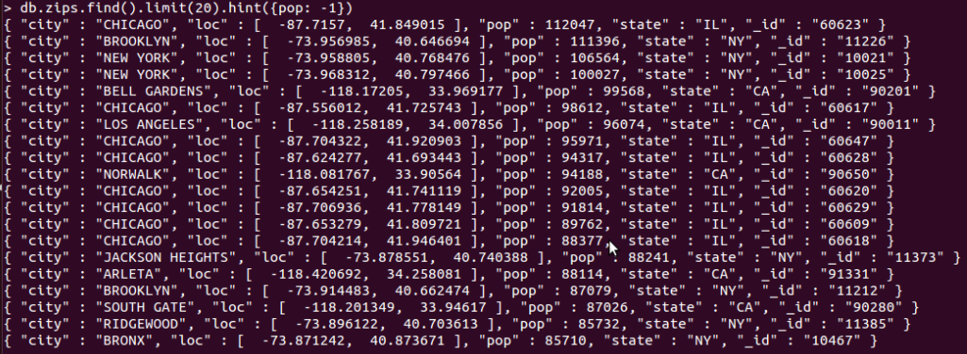
Demo of indexes in MongoDB
Import Data
Create Index
Single Field Index
Compound Field Indexes
Multikey Indexes
Show Existing Index
Hint
Single Field Index
Compound Field Indexes
Multikey Indexes
Explain
Compare with data without indexes

Slide 14
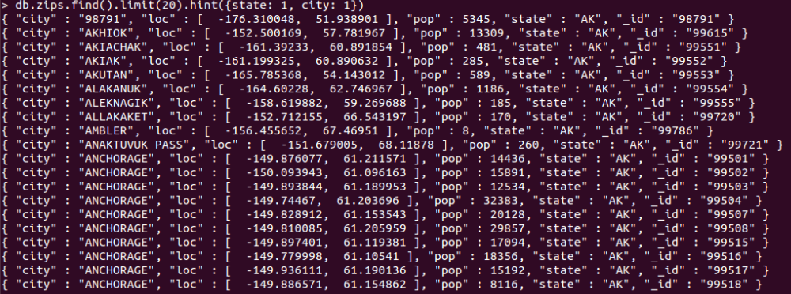
Demo of indexes in MongoDB
Import Data
Create Index
Single Field Index
Compound Field Indexes
Multikey Indexes
Show Existing Index
Hint
Single Field Index
Compound Field Indexes
Multikey Indexes
Explain
Compare with data without indexes

Slide 15
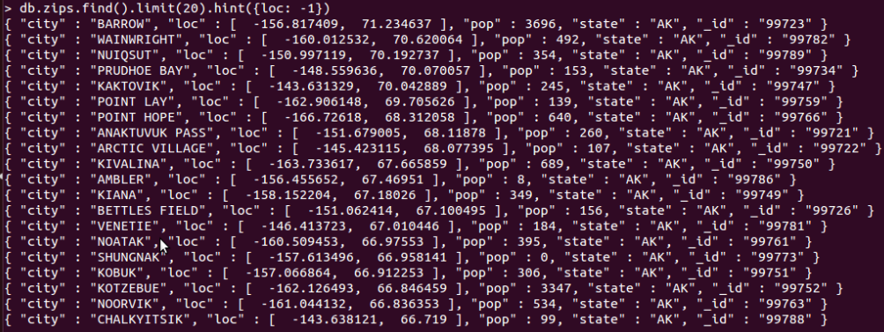
Demo of indexes in MongoDB
Import Data
Create Index
Single Field Index
Compound Field Indexes
Multikey Indexes
Show Existing Index
Hint
Single Field Index
Compound Field Indexes
Multikey Indexes
Explain
Compare with data without indexes

Slide 16
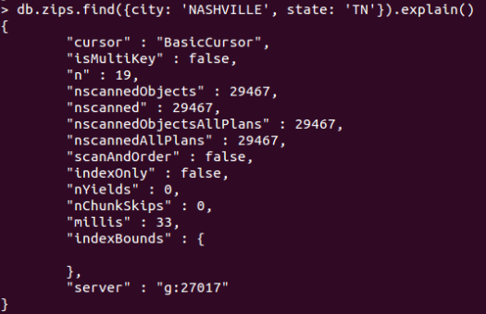
Demo of indexes in MongoDB
Import Data
Create Index
Single Field Index
Compound Field Indexes
Multikey Indexes
Show Existing Index
Hint
Single Field Index
Compound Field Indexes
Multikey Indexes
Explain
Compare with data without indexes

Slide 17
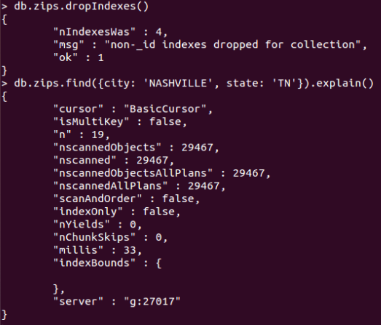
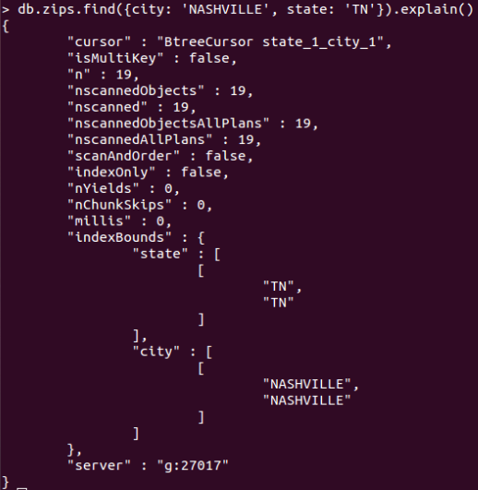
Demo of indexes in MongoDB
Without Index
Import Data
Create Index
Single Field Index
Compound Field Indexes
Multikey Indexes
Show Existing Index
Hint
Single Field Index
Compound Field Indexes
Multikey Indexes
Explain
Compare with data without indexes
With Index

Slide 18
Aggregation Framework Operators
$group
$project
$match
$limit
$skip
$sort
$unwind

Slide 19
Possible stages in aggregation
$project − Used to select some specific fields from a collection.
$match − This is a filtering operation and thus this can reduce the amount of documents that are given as input to the next stage.
$group − This does the actual aggregation as discussed above.
$sort − Sorts the documents.
$skip − With this, it is possible to skip forward in the list of documents for a given amount of documents.
$limit − This limits the amount of documents to look at, by the given number starting from the current positions.
$unwind − This is used to unwind document that are using arrays. When using an array, the data is kind of pre-joined and this operation will be undone with this to have individual documents again. Thus with this stage we will increase the amount of documents for the next stage.

Slide 20
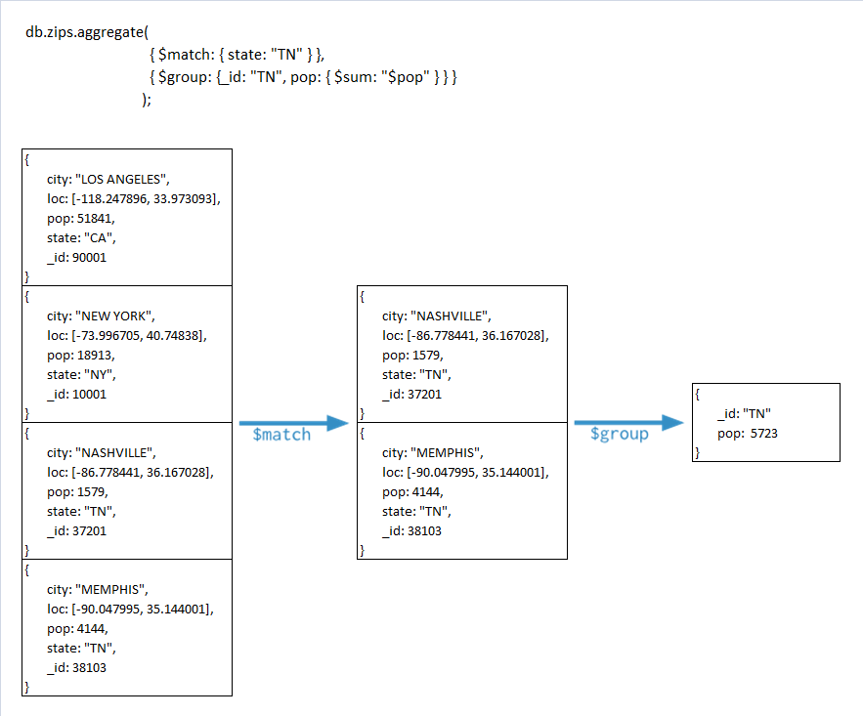

Slide 21
Collection creation to run practical
db.student.insert({Rollno:1,name:'Navin ',subject:'DMSA',marks:78});
db.student.insert({Rollno:2,name:'anusha',subject:'OSD',marks:75});
db.student.insert({Rollno:3,name:'ravi',subject:'TOC',marks:69});
db.student.insert({Rollno:4,name:'veena',subject:'TOC',marks:70});
db.student.insert({Rollno:5,name: ‘Pravini',subject: ‘OSD',marks:80});
db.student.insert({Rollno:6,name: ‘Reena',subject: ‘DMSA',marks:50});
db.student.insert({Rollno:7,name: ‘Geeta',subject: ‘CN',marks:90});
db.student.insert({Rollno:8,name: ‘Akash',subject: ‘CN',marks:85});

Slide 22
MIN()
db.student.aggregate ([{$group : {_id : "$subject",marks : {$min : "$marks"}}}]);
SQL Equivalent Query
Select subject, min(marks) from student group by subject

Slide 23
MAX()
db.student.aggregate ([{$group : {_id : "$subject", marks : {$max : "$marks"}}}]);
SQL Equivalent Query
Select subject, max(marks) from student group by subject

Slide 24
AVG()
db.student.aggregate ([{$group : {_id : "$subject",marks : {$avg : "$marks"}}}]);
SQL Equivalent Query
Select subject, avg(marks) from student group by subject

Slide 25
FIRST()
db.student.aggregate([{$group : {_id : "$subject",marks : {$first : "$marks"}}}]);

Slide 26
LAST()
db.student.aggregate ([{$group : {_id : "$subject",marks : {$last : "$marks"}}}]);

Slide 27
SUM()-Example 1
db.student.aggregate ([{$group : {_id : "$subject",marks : {$sum :"$marks"}}}]);
SQL Equivalent Query
Select subject, sum(marks) from student group by subject

Slide 28
SUM(): Example 2
db.student.aggregate ([{$group : {_id : "$subject",Count: {$sum : 1}}}]);
SQL Equivalent Query
Select subject, count(*) from student group by subject

Slide 29
$match
db.student.aggregate([{ $match: {subject:"OSD"}}])
db.student.aggregate([{$match:{subject:"OSD"}},{$group:{_id:null,count:{$sum:1}}}]);

Slide 30
SUM()- Example 3
db.student.aggregate([{ $match: {subject:"OSD"}},{$group:{_id:null,count:{$sum:1}}}]);
SQL Equivalent Query
Select subject, count(*) from student group by subject having subject=“OSD”

Slide 31
Limit() & Skip()
db.student.aggregate([{ $match: {subject:"OSD"}},{$limit:1}]);
db.student.aggregate([{ $match: {subject:"OSD"}},{$skip:1}]);

Slide 32
Sort()
db.student.aggregate([{ $match: {subject:"OSD"}},{$sort:{marks:-1}}]);
db.student.aggregate([{ $match: {subject:"OSD"}},{$sort:{marks:1}}]);

Slide 33
Unwind()
If following document is their in collection(Array)
db.student.insert({rollno:9,name:"Anavi",marks:[80,30,50]});
Using Unwind the above document will be unwinded into 3 different document
db.student.aggregate([{$unwind:"$marks"}])

Slide 34
BATCH-A EXERCISE

Slide 35
Create Institute Database and Create Student collection with following keys
{
Student Id :
Student Name:
Branch:
Age:
Panel:
Address:{
Area:
City:
Pincode:
}
Subjects :[
{
subject name1:
score1:
}
{
subject name2:
score2:
}
]
Area of Interest : [“ DBMS”,”Networking”.....]
}
* Enter Subject Names as : 1. DBMS 2. TOC 3. IS 4. AI

Slide 36
Aggregation Operations : Solve Queries
Create database Institute
Create collection Student.
Insert 10 documents with above mentioned structure.
Display all student information.
Display the Five Most Common “Area of Interest”.
Display minimum, maximum and average marks scored in each subject
Display total marks scored by each student
Display names of student who have scored more than 80 marks in subject1
Display total no of students from ‘Pune’.
Display Panel vise count of students.
Display branch vise count of students.
Display all panel whose strength is more than 60

Slide 37
Indexing and querying with MongoDB using suitable example.
Import holidays.json
Perform all these operations.
Import Data
Create Index
Single Field Index
Compound Field Indexes
Multikey Indexes
Show Existing Index
Hint
Single Field Index
Compound Field Indexes
Multikey Indexes
Explain
Compare with data without indexes

Slide 38
BATCH-B EXERCISE

Slide 39
Create Company Database and Create Employee collection with following key
{
"firstName": "John",
"lastName": "Smith",
"age": 25,
"address":
{
"streetAddress": "21 2nd Street",
"city": "New York",
"state": "NY",
"postalCode": "10021"
},
"phoneNumber":
[
{
"type": "home",
"number": "212 555-1234"
},
{
"type": "fax",
"number": "646 555-4567"
}
]
“emailAddress": [ “romin.k.irani@gmail.com” , “tomhanks@gmail.com”] }

Slide 40
Aggregation Operations : Solve Queries
Create database Company.
Create collection Employee.
Insert 10 documents with above mentioned structure.
Display all Employee Information.
Display state vise total employee
Display count of employees of ‘NY’ state
Display all the states where more than 10 employees are working
Display count of employees having age less than 30
Display name of employees having more than two phone nos.
How many employees have provided home phone no
Display employee vise count of email addresses.

Slide 41
Indexing and querying with MongoDB using suitable example.
Import books.json
Perform all these operations.
Write your analysis
Import Data
Create Index
Single Field Index
Compound Field Indexes
Multikey Indexes
Show Existing Index
Hint
Single Field Index
Compound Field Indexes
Multikey Indexes
Explain
Compare with data without indexes

Slide 42
BATCH-C EXERCISE

Slide 43
Create Restaurant Database and Create Hotel collection with following keys
{
Hotel Id:
Hotel Name:
Type:
Ratings
Address:{
Area:
City:
Pincode:
}
Rooms :[
{
Roomno:
Type:
Price:
}
{
Roomno:
Type:
Price:
}
]
Cuisines : [“Indian”,”Italian”,”Chinese”.....]
likes:
}

Slide 44
Aggregation Operations : Solve Queries
Create database Restaurant.
Create collection Hotel.
Insert 10 documents with above mentioned structure.
Display all Hotel information.
Display no of rooms in each hotel
Compute the top five hotels
Return hotels having likes above 1000
Return the Five Most Common Cuisines
Return all prices of room in different hotel of type ‘Deluxe' .
Get the total count of hotels having ratings ‘5 star’
Display the count of hotels from ‘Pune’ city.

Slide 45
Indexing and querying with MongoDB using suitable example.
Import restaurant.json
Perform all these operations.
Write your analysis
Import Data
Create Index
Single Field Index
Compound Field Indexes
Multikey Indexes
Show Existing Index
Hint
Single Field Index
Compound Field Indexes
Multikey Indexes
Explain
Compare with data without indexes

Slide 46
BATCH-D EXERCISE

Slide 47
Create Theatre Database and Create Movies collection with following keys
{
"title": "",
"year": "",
"directors": [
{
"Name": "",
"DOB": "",
"Adress": "",
"TelNo": ""
}
],
"writers": [
{
"Name": "",
"DOB": "",
"Adress": "",
"TelNo": ""
}
],
"stars": [
{
"Name": "",
"DOB": "",
"Adress": "",
"TelNo": "“ } ]
“tags”:[“comedy”,”action”]
“likes”: }

Slide 48
Aggregation Operations : Solve Queries
Create database Theatre.
Create collection Movie.
Insert 10 documents with above mentioned structure.
Display all Movies information.
Display the count of movies having tag ‘comedy’
Display three most common tags
Display the top five movies
Display the count of writers for each movie
Display the count of stars for each movie
Display the count of producers for each movie
Display the count of movies produced by each producers
Display the count of movies in which ‘Amir khan’ has worked as star
Display the name of writers who have written more than 3 movies
Display the name of movies ordered by year of release

Slide 49
Indexing and querying with MongoDB using suitable example.
Import zips.json
Perform all these operations.
Write your analysis
Import Data
Create Index
Single Field Index
Compound Field Indexes
Multikey Indexes
Show Existing Index
Hint
Single Field Index
Compound Field Indexes
Multikey Indexes
Explain
Compare with data without indexes

Slide 50
Thank you

